Slide 1
SDS 384 Regression Analysis
FAC 101B• MW 1:00-2:30 • Fall 2018
Professor: Teaching Assistant:
Matt Hersh Novin Ghafari
Matt.hersh@austin.utexas.edu Novinjun@yahoo.com
Office: GDC 7.505 Office: GDC 1.406
Office Hours: T 2:30-3:30 O Hours: M 10:00-11:00
Textbooks:
Optional: Kutner, Nachtsheim, and Neter, Applied Linear Regression Models, 4th Edition.
Kutner, Nachtsheim, Neter, and Li, Applied Linear Statistical Models, 5th Edition.
Alan Agresti and Barbara Finlay, Statistical Methods for the Social Sciences, 4th Edition.

Slide 2
SDS 384 Regression Analysis
FAC 101B• MW 1:00-2:30 • Fall 2018
Software: We will be using the software package SAS. SAS is available in many computer labs on campus. In addition, you may also pay a minimal fee to access SAS from your home or office on the SDS application server. For more information, see:
https://stat.utexas.edu/consulting/stat-apps-server?mobile=false_desktop
Grading:
In-Class Labs 15%
Homework 25%
Exam 1 30%
Exam 2 30%
Canvass: : Announcements, problem sets, and handouts will be posted on the SDS 384 Canvass site (http://courses.utexas.edu).

Slide 3
SDS 384 Regression Analysis
FAC 101B• MW 1:00-2:30 • Fall 2018
Homework: There will problem sets assigned throughout the semester. The homeworks count for 30% of your grade.
Exams:
There will be 2 exams. They each will count for 30% of your grade. They are tentatively scheduled for Wednesday October 24th and Monday December 10th. These dates are subject to change. You may use calculators but absolutely no cell phones are allowed during the exams.
Note the third exam is scheduled for December 10th, the last day of class, not on Saturday.

Slide 4
Relations between variables
A functional relationship between two variables is expressed by a mathematical formula.
For an independent variable X and a dependent variable Y, a functional relationship has the form
Y= f(X)
For example, if we sell widgets for 2 dollars a piece, the total sales, Y, can be expressed as a function of the number of widgets sold, X.
Y= 2X

Slide 5
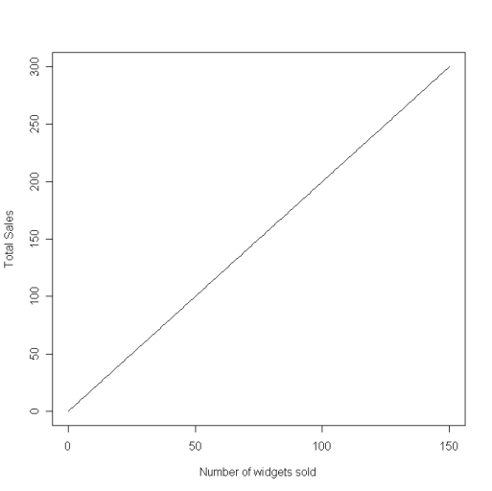

Relations between variables
This functional relationship is a straight line.
For 3 periods, we observed the data below.
Period | # of widgets sold | Total Sales
1 | 75 | 150
2 | 25 | 50
3 | 130 | 260

Slide 6

Relations between variables
If we plot the observations onto the straight line produced by the function, they all fall exactly on the line.
A statistical relationship, unlike a functional relationship, is not a perfect one. In general, the observations for a statistical relationship do not fall directly on the curve of relationship.

Slide 7
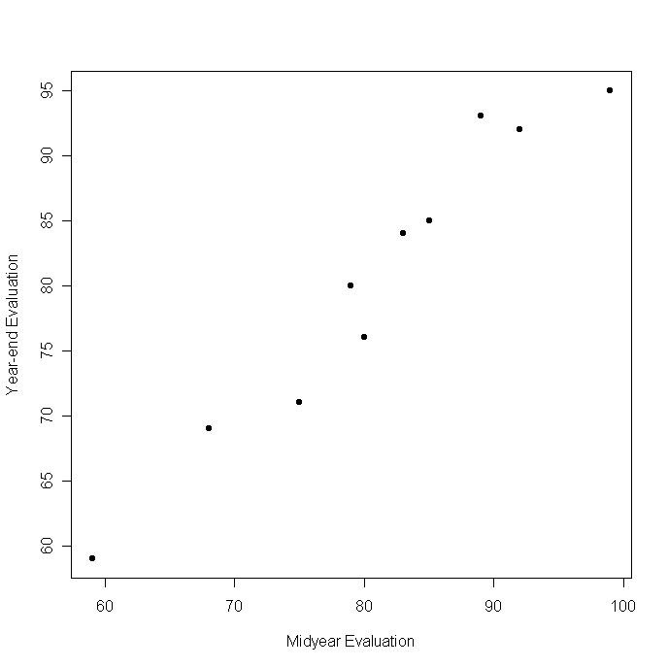
Relations between variables
For example, performance evaluations for 10 employees were taken at mid-year and at the end of the year.
The year-end evaluations are the dependent variable, Y, and the mid-year evaluations are the independent variable, X.
A plot of the observations clearly suggests there is a relationship between mid-year and year-end evaluations.

Slide 8
Relations between variables
The higher the mid-year evaluations, the higher the year-end evaluations tend to be. But this is not a perfect relationship.
There is a “scattering” of points, suggesting that some of the variation in year-end reviews is not accounted for by mid-year reviews.
This type of plot is called a scatter plot.

Slide 9
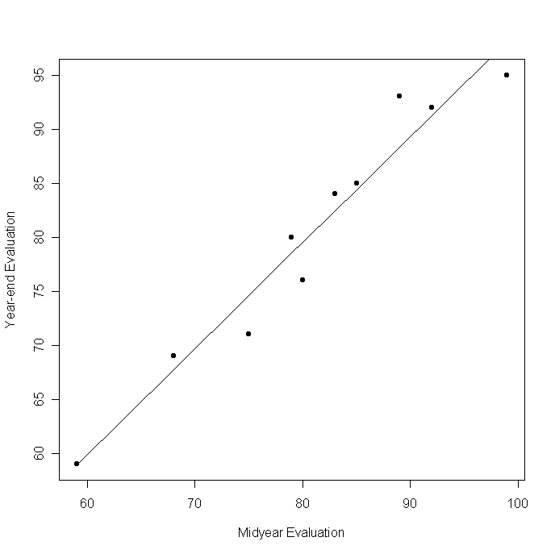
Relations between variables
We have plotted a line that describes the relationship between mid-year and year-end reviews.
The scattering of points around the line represents variation in year-end reviews not associated with mid-year reviews.
This unaccounted for variation is typically considered random.

Slide 10
Regression Models
A regression model is a formal means of expressing two essential ingredients of a statistical relationship:
A tendency of the response variable Y to vary with the predictor variable X in a systematic fashion.
A scattering of points around the curve of statistical relationship.

Slide 11
Regression Models
These two characteristics are embodied in a regression model by postulating that
There is a probability distribution of Y for each level of X.
The means of these probability distributions vary in some systematic fashion with X.
Recall the evaluation example. The year-end evaluation Y is treated in a regression model as a random variable.
For each level of mid-year evaluation X, there is a probability distribution of Y.

Slide 12
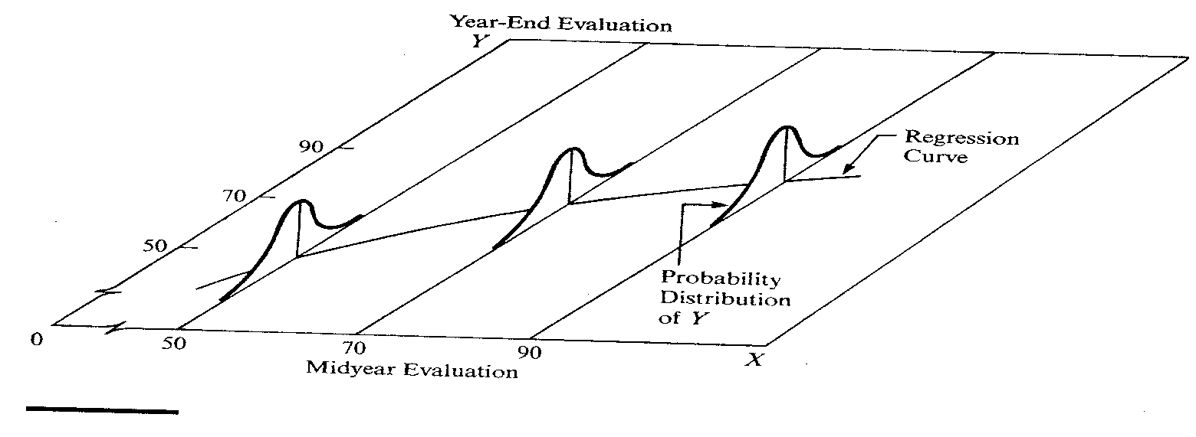
Regression Models
This figure shows such a probability distribution of Y for X=90.
The actual year-end evaluation of this employee, y=94, is then viewed as a random selection from this probability distribution.

Slide 13
Regression Models
This figure also shows probability distributions of Y for X=50 and X=70.
The means of the probability distributions have a systematic relationship to the level of X.

Slide 14
Regression Models
This systematic relationship is called the regression function of Y on X.
The graph of the regression function is called the regression curve.

Slide 15
Regression Models
Regression models can also contain more than one predictor variable. For example, we could use height, gender, and amount of exercise to predict weight.
When constructing a regression model, we need to choose what predictor variables to include.
A major consideration in choosing predictor variables is the extent to which they explain unaccounted for variation in Y.
For example, we may believe that diet explains variation in weight that is not already accounted for by gender, height, and amount of exercise.

Slide 16
Regression Models
In formulating a regression model, we usually need to restrict the coverage of the model to some interval or region of values of the predictor variables.
The scope is determined either by the design of the investigation or by the range of the data.
For instance, a company studying the effects of price on sales volume investigated 6 price levels, ranging from 5$ to 7$
The shape of the regression function substantially outside this range would be in serious doubt because the investigation provided no evidence as to the statistical relation below 5$ or above 7$.

Slide 17
Regression Models
A statistical relationship between a response variable and an explanatory variable does not imply a cause and effect relationship.
If we were to model the number of accidents at an intersection, Y, as a function of the number of panhandlers at the intersection, X, we would determine there is a statistical relationship between the two.
Does this mean that panhandlers cause accidents?

Slide 18

Simple Linear Regression
A basic regression model that is linear and has only one predictor can be stated as
where:
Y_{i} is the value of the response in the i^{th} trial.
β₀ and β₁ are parameters
X_{i} is the value of the predictor variable in the i^{th} trial.
ε_{i} is a random error term with mean E{ε_{i}} = 0 and var{ε_{i}} = σ².
For all i≠j, ε_{i} and ε_{j} are uncorrelated (independent) and thus their covariance is 0. We write that as σ(ε_{i},ε_{j}) = 0.

Slide 19
Simple Linear Regression
This model is simple, since there is only one predictor variable.
It is linear in the parameters since no parameter is an exponent or multiplied or divided by another parameter.
It is linear in the predictor variable because the predictor variable is only in the first power.
A model that is linear in the parameters and the predictor variable is a first order model.

